Slide 1

CSE404
GUMS needs changes
Course Instructor-
Md. Abdullah Al Arif
Lecturer
Dept. of CSE
Green University of Bangladesh
Presented by-
Md. Zahidul Hasan 183002076 Shovon Sikder 183002045 Rafatul Islam 183002013
Section: 183_DC
CLASSIFICATION OF STUDENTS
BASED ON THEIR PERFORMANCE DATA-SET

Slide 2
CSE404
CLASSIFICATION OF STUDENTS
BASED ON THEIR PERFORMANCE DATA-SET
Course Instructor-
Md. Abdullah Al Arif
Lecturer
Dept. of CSE
Green University of Bangladesh
Presented by-
Md. Zahidul Hasan 183002076 Shovon Sikder 183002045 Rafatul Islam 183002013
Section: 183_DC

Slide 3
CLASSIFICATION OF STUDENTS
BASED ON THEIR PERFORMANCE DATA-SET

Slide 4
Presentation Contents
----- ----- ----- -----
Introduction
5
Dataset Information
12
Attributes Information
13
Grading System preprocess
12
Analysis and Graph
19
Classifier selection
25
Building model
30
Android Application
37
Conclusions
28
References
40

Slide 5


Introduction
----- ----- -----

Slide 6
Introduction
----- ----- -----
Each student has a distinct personality
We'll analyze student performance

Slide 7



Introduction
----- ----- -----
Manually tracking individual student’s performance is not an easy task
The institute with huge number of students can’t help individuals for the lacking of proper monitoring
Not all the students are brilliant so each student should get different method of learning
Our project will be helpful to classify students based on their performance so that authority can take proper care of them

Slide 8
Dataset Information
----- ----- -----
This data approach student achievement in secondary education of two Portuguese schools.
The data attributes include: student grades,
demographic,
social and school related features
Collected by using school reports and questionnaires.
performance in two distinct subjects: Mathematics (mat) and Portuguese language (por).
G3 has a strong correlation with attributes G2 and G1.
G3 is the final year grade (issued at the 3rd period), while G1 and G2 correspond to the 1st and 2nd period grades.
[1]
Notes:
This data approach student achievement in secondary education of two Portuguese schools. The data attributes include student grades, demographic, social and school related features) and it was collected by using school reports and questionnaires. Two datasets are provided regarding the performance in two distinct subjects: Mathematics (mat) and Portuguese language (por). In [Cortez and Silva, 2008], the two datasets were modeled under binary/five-level classification and regression tasks. Important note: the target attribute G3 has a strong correlation with attributes G2 and G1. This occurs because G3 is the final year grade (issued at the 3rd period), while G1 and G2 correspond to the 1st and 2nd period grades. It is more difficult to predict G3 without G2 and G1, but such prediction is much more useful (see paper source for more details).

Slide 9
Attributes Information
----- ----- -----
1 school - student's school (binary: 'GP' - Gabriel Pereira or 'MS' - Mousinho da Silveira) 2 sex - student's sex (binary: 'F' - female or 'M' - male) 3 age - student's age (numeric: from 15 to 22) 4 address - student's home address type (binary: 'U' - urban or 'R' - rural) 5 famsize - family size (binary: 'LE3' - less or equal to 3 or 'GT3' - greater than 3) 6 Pstatus - parent's cohabitation status (binary: 'T' - living together or 'A' - apart) 7 Medu - mother's education (numeric: 0 - none, 1 - primary education (4th grade), 2 â€“ 5th to 9th grade, 3 â€“ secondary education or 4 â€“ higher education) 8 Fedu - father's education (numeric: 0 - none, 1 - primary education (4th grade), 2 â€“ 5th to 9th grade, 3 â€“ secondary education or 4 â€“ higher education) 9 Mjob - mother's job (nominal: 'teacher', 'health' care related, civil 'services' (e.g. administrative or police), 'at_home' or 'other') 10 Fjob - father's job (nominal: 'teacher', 'health' care related, civil 'services' (e.g. administrative or police), 'at_home' or 'other') 11 reason - reason to choose this school (nominal: close to 'home', school 'reputation', 'course' preference or 'other') 12 guardian - student's guardian (nominal: 'mother', 'father' or 'other') 13 traveltime - home to school travel time (numeric: 1 - <15 min., 2 - 15 to 30 min., 3 - 30 min. to 1 hour, or 4 - >1 hour) 14 studytime - weekly study time (numeric: 1 - <2 hours, 2 - 2 to 5 hours, 3 - 5 to 10 hours, or 4 - >10 hours) 15 failures - number of past class failures (numeric: n if 1<=n<3, else 4) 16 schoolsup - extra educational support (binary: yes or no) 17 famsup - family educational support (binary: yes or no) 18 paid - extra paid classes within the course subject (Math or Portuguese) (binary: yes or no) 19 activities - extra-curricular activities (binary: yes or no) 20 nursery - attended nursery school (binary: yes or no) 21 higher - wants to take higher education (binary: yes or no) 22 internet - Internet access at home (binary: yes or no) 23 romantic - with a romantic relationship (binary: yes or no) 24 famrel - quality of family relationships (numeric: from 1 - very bad to 5 - excellent) 25 freetime - free time after school (numeric: from 1 - very low to 5 - very high) 26 goout - going out with friends (numeric: from 1 - very low to 5 - very high) 27 Dalc - workday alcohol consumption (numeric: from 1 - very low to 5 - very high) 28 Walc - weekend alcohol consumption (numeric: from 1 - very low to 5 - very high) 29 health - current health status (numeric: from 1 - very bad to 5 - very good) 30 absences - number of school absences (numeric: from 0 to 93)

Slide 10
Attributes Information
----- ----- -----
1 school - student's school (binary: 'GP' - Gabriel Pereira or 'MS' - Mousinho da Silveira) 2 sex - student's sex (binary: 'F' - female or 'M' - male) 3 age - student's age (numeric: from 15 to 22) 4 address - student's home address type (binary: 'U' - urban or 'R' - rural) 5 famsize - family size (binary: 'LE3' - less or equal to 3 or 'GT3' - greater than 3) 6 Pstatus - parent's cohabitation status (binary: 'T' - living together or 'A' - apart) 7 Medu - mother's education (numeric: 0 - none, 1 - primary education (4th grade), 2 â€“ 5th to 9th grade, 3 â€“ secondary education or 4 â€“ higher education) 8 Fedu - father's education (numeric: 0 - none, 1 - primary education (4th grade), 2 â€“ 5th to 9th grade, 3 â€“ secondary education or 4 â€“ higher education) 9 Mjob - mother's job (nominal: 'teacher', 'health' care related, civil 'services' (e.g. administrative or police), 'at_home' or 'other') 10 Fjob - father's job (nominal: 'teacher', 'health' care related, civil 'services' (e.g. administrative or police), 'at_home' or 'other') 11 reason - reason to choose this school (nominal: close to 'home', school 'reputation', 'course' preference or 'other') 12 guardian - student's guardian (nominal: 'mother', 'father' or 'other') 13 traveltime - home to school travel time (numeric: 1 - <15 min., 2 - 15 to 30 min., 3 - 30 min. to 1 hour, or 4 - >1 hour) 14 studytime - weekly study time (numeric: 1 - <2 hours, 2 - 2 to 5 hours, 3 - 5 to 10 hours, or 4 - >10 hours) 15 failures - number of past class failures (numeric: n if 1<=n<3, else 4) 16 schoolsup - extra educational support (binary: yes or no) 17 famsup - family educational support (binary: yes or no) 18 paid - extra paid classes within the course subject (Math or Portuguese) (binary: yes or no) 19 activities - extra-curricular activities (binary: yes or no) 20 nursery - attended nursery school (binary: yes or no) 21 higher - wants to take higher education (binary: yes or no) 22 internet - Internet access at home (binary: yes or no) 23 romantic - with a romantic relationship (binary: yes or no) 24 famrel - quality of family relationships (numeric: from 1 - very bad to 5 - excellent) 25 freetime - free time after school (numeric: from 1 - very low to 5 - very high) 26 goout - going out with friends (numeric: from 1 - very low to 5 - very high) 27 Dalc - workday alcohol consumption (numeric: from 1 - very low to 5 - very high) 28 Walc - weekend alcohol consumption (numeric: from 1 - very low to 5 - very high) 29 health - current health status (numeric: from 1 - very bad to 5 - very good) 30 absences - number of school absences (numeric: from 0 to 93)

Slide 11
Grading System Preprocess
----- ----- -----
Grading
16-20 | A | Pass
14-15 | B
12-13 | C
10-11 | D
0-9 | F | Fail

Slide 12
Grading System Preprocess
----- ----- -----
… | Walc | health | absences | G1 | G2 | G3
… | 1 | 3 | 4 | 0 | 11 | 11
… | 1 | 3 | 2 | 9 | 11 | 11
… | 3 | 3 | 6 | 12 | 13 | 12
… | 1 | 5 | 0 | 14 | 14 | 14

Slide 13
Grading System Preprocess
----- ----- -----
… | Walc | health | absences | G1 | G2 | G3
… | 1 | 3 | 4 | 0 | 11 | 11
… | 1 | 3 | 2 | 9 | 11 | 11
… | 3 | 3 | 6 | 12 | 13 | 12
… | 1 | 5 | 0 | 14 | 14 | 14
… | Walc | health | absences | G1 | G2 | G3
… | 1 | 3 | 4 | 0 | 11 | D
… | 1 | 3 | 2 | 9 | 11 | D
… | 3 | 3 | 6 | 12 | 13 | C
… | 1 | 5 | 0 | 14 | 14 | B
… | Walc | health | absences | G1 | G2 | G3
… | 1 | 3 | 4 | 0 | 11 | Pass
… | 1 | 3 | 2 | 9 | 11 | Pass
… | 3 | 3 | 6 | 12 | 13 | Pass
… | 1 | 5 | 0 | 14 | 14 | Pass

Slide 14
Methodology
----- ----- -----
CSV
Arff format

Slide 15
Methodology
----- ----- -----
CSV
Arff format
Classify

Slide 16
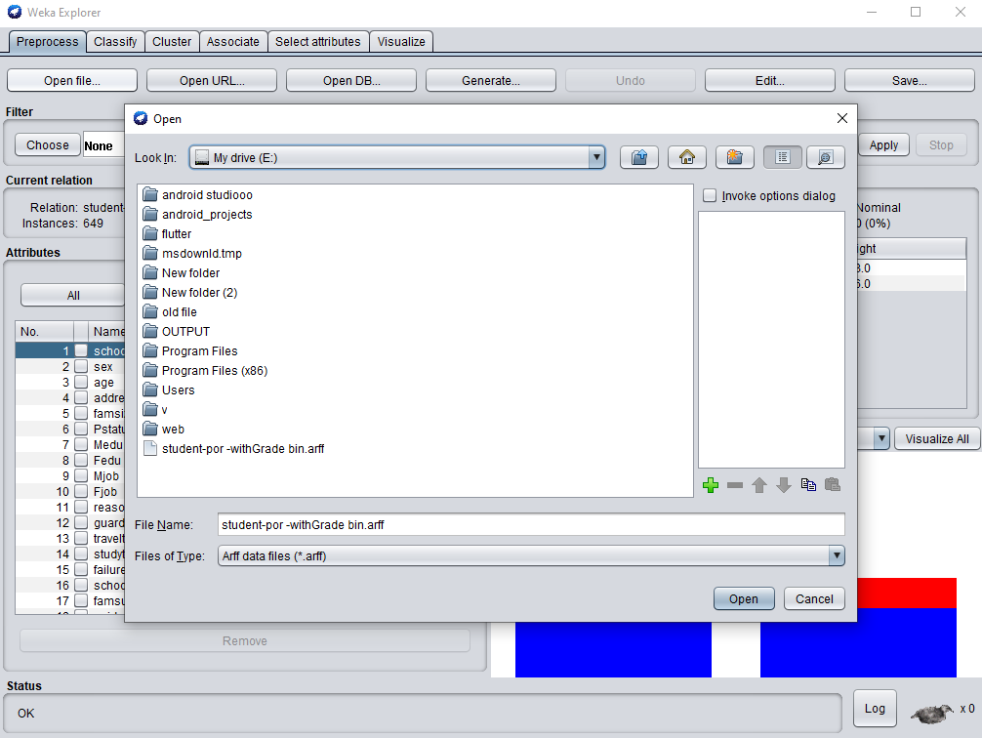
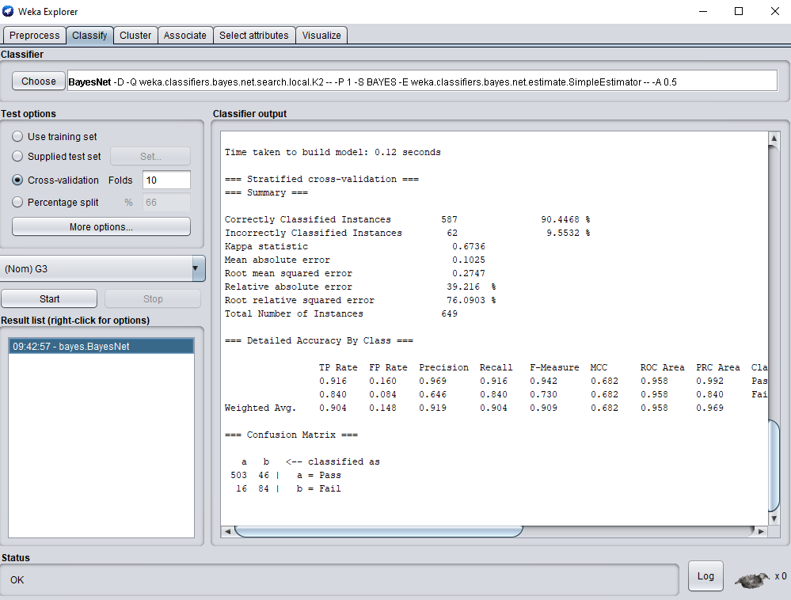
Methodology
----- ----- -----

Slide 17
Methodology
----- ----- -----

Slide 18
Methodology
----- ----- -----
Students performance classification
AI Lab exp. |  | Classifier Performance (5-Level {A,B,C,D,F})
No_Of_Fold | Bayesnet | NaiveBayes | NBU | LibSVM | LR | MLP | SLR | ASC | FC | RSS | DT | OneR | J48 | LMT | Random_forest | REPTree
2 | 71.65% | 66.26% | 66.26% | 67.95% | 59.17% | 52.85% | 70.88% | 76.43% | 74.42% | 72.27% | 74.27% | 76.73% | 68.10% | 67.80% | 69.95% | 74.42%
3 | 72.11% | 67.33% | 67.33% | 69.03% | 63.48% | 54.70% | 71.03% | 75.50% | 73.34% | 75.35% | 75.35% | 76.73% | 69.18% | 71.96% | 71.65% | 75.35%
4 | 71.03% | 66.56% | 66.56% | 72.73% | 65.49% | 57.94% | 69.95% | 75.50% | 74.73% | 73.65% | 75.81% | 76.73% | 69.34% | 69.95% | 72.57% | 72.57%
5 | 71.03% | 66.41% | 66.41% | 71.80% | 66.10% | 57.63% | 70.42% | 75.19% | 73.19% | 75.50% | 74.42% | 76.73% | 69.95% | 70.72% | 72.73% | 74.58%
6 | 72.27% | 67.33% | 67.33% | 71.19% | 68.57% | 55.01% | 71.34% | 74.88% | 75.04% | 75.81% | 73.81% | 76.73% | 69.18% | 72.27% | 71.19% | 74.42%
7 | 72.11% | 67.49% | 67.49% | 69.95% | 67.64% | 56.39% | 71.80% | 75.35% | 73.19% | 75.19% | 75.35% | 76.73% | 68.26% | 71.65% | 71.34% | 75.35%
8 | 70.42% | 66.87% | 66.87% | 71.34% | 66.41% | 57.16% | 72.57% | 76.27% | 74.27% | 73.81% | 75.96% | 76.73% | 70.42% | 72.73% | 71.49% | 73.81%
9 | 72.11% | 66.56% | 66.56% | 70.26% | 66.72% | 59.94% | 72.11% | 75.96% | 74.42% | 76.12% | 74.58% | 76.73% | 68.88% | 72.57% | 71.65% | 75.04%
10 | 72.42% | 68.26% | 68.26% | 71.96% | 66.72% | 57.16% | 71.34% | 75.65% | 74.11% | 75.50% | 75.81% | 76.73% | 67.80% | 71.65% | 73.50% | 75.19%
11 | 71.80% | 68.10% | 68.10% | 71.80% | 67.03% | 55.78% | 71.49% | 75.19% | 73.81% | 75.96% | 76.27% | 76.73% | 69.34% | 71.49% | 72.88% | 75.04%
12 | 72.27% | 66.72% | 66.72% | 70.88% | 67.49% | 59.01% | 72.11% | 74.11% | 72.88% | 76.27% | 76.58% | 76.73% | 67.64% | 72.11% | 73.96% | 74.58%
13 | 71.34% | 67.49% | 67.49% | 70.88% | 66.41% | 53.47% | 69.95% | 74.27% | 74.27% | 74.58% | 75.35% | 76.73% | 69.34% | 69.34% | 73.04% | 74.73%
14 | 71.34% | 67.33% | 67.33% | 71.49% | 67.64% | 57.01% | 71.19% | 74.11% | 74.73% | 73.96% | 75.19% | 76.73% | 68.57% | 71.96% | 73.19% | 75.19%
15 | 72.27% | 66.41% | 66.41% | 71.03% | 66.26% | 57.32% | 71.96% | 74.73% | 73.65% | 75.65% | 74.88% | 76.73% | 68.72% | 71.80% | 74.42% | 75.04%
AVG= | 71.73 | 67.08 | 67.08 | 70.88 | 66.08 | 56.53 | 71.30 | 75.23 | 74.00 | 74.97 | 75.26 | 76.73 | 68.91 | 71.29 | 72.40 | 74.66
AI Lab exp. |  | Classifier Performance (Binary {pass,fail})
No_Of_Fold | Bayesnet | NaiveBayes | NBU | LibSVM | LR | MLP | SLR | ASC | FC | RSS | DT | OneR | J48 | LMT | Random_forest | REPTree
2 | 90.14% | 87.21% | 87.21% | 92.30% | 88.91% | 88.29% | 90.76% | 92.60% | 93.22% | 93.68% | 92.91% | 93.68% | 91.83% | 90.76% | 93.07% | 92.30%
3 | 91.99% | 88.60% | 88.60% | 92.76% | 91.22% | 88.91% | 92.91% | 92.76% | 93.07% | 93.07% | 92.91% | 93.68% | 91.83% | 92.91% | 92.76% | 93.68%
4 | 90.29% | 88.14% | 88.14% | 92.91% | 90.76% | 89.21% | 92.91% | 93.22% | 92.76% | 92.45% | 92.30% | 93.68% | 91.22% | 91.53% | 92.76% | 92.91%
5 | 90.60% | 87.98% | 87.98% | 92.45% | 91.99% | 87.37% | 92.76% | 92.76% | 92.45% | 92.91% | 92.14% | 93.68% | 91.68% | 92.76% | 92.45% | 92.91%
6 | 89.68% | 87.98% | 87.98% | 92.76% | 90.60% | 88.60% | 92.91% | 92.76% | 92.14% | 93.53% | 91.22% | 93.68% | 90.91% | 92.91% | 91.99% | 93.22%
7 | 90.91% | 88.29% | 88.29% | 92.60% | 91.53% | 90.45% | 92.45% | 92.76% | 93.07% | 92.76% | 92.76% | 93.68% | 92.60% | 92.45% | 93.37% | 92.76%
8 | 89.52% | 88.14% | 88.14% | 91.99% | 90.45% | 88.75% | 91.99% | 92.91% | 93.53% | 93.22% | 92.45% | 93.68% | 91.53% | 91.99% | 93.68% | 92.30%
9 | 90.45% | 88.29% | 88.29% | 92.60% | 92.60% | 90.14% | 92.30% | 92.45% | 93.53% | 93.37% | 93.22% | 93.68% | 91.53% | 91.99% | 92.60% | 92.60%
10 | 90.45% | 88.44% | 88.44% | 93.07% | 91.37% | 89.68% | 93.22% | 92.60% | 93.53% | 92.30% | 92.60% | 93.68% | 91.37% | 93.22% | 92.76% | 93.22%
11 | 91.06% | 88.91% | 88.91% | 92.91% | 92.45% | 90.29% | 92.45% | 91.68% | 93.22% | 92.30% | 92.76% | 93.68% | 92.30% | 92.45% | 92.76% | 92.91%
12 | 90.14% | 88.29% | 88.29% | 93.07% | 90.91% | 89.68% | 92.60% | 92.91% | 92.45% | 93.22% | 91.22% | 93.68% | 91.99% | 92.45% | 92.91% | 93.22%
13 | 91.06% | 88.14% | 88.14% | 92.60% | 91.37% | 89.06% | 92.30% | 91.83% | 92.76% | 93.07% | 92.76% | 93.68% | 91.83% | 92.30% | 93.53% | 92.60%
14 | 90.91% | 88.44% | 88.44% | 92.45% | 91.22% | 88.91% | 92.45% | 93.53% | 92.76% | 92.76% | 92.30% | 93.68% | 91.53% | 92.45% | 92.91% | 92.60%
15 | 90.76% | 87.98% | 87.98% | 92.76% | 92.14% | 89.52% | 92.76% | 93.53% | 92.30% | 92.45% | 92.76% | 93.68% | 92.45% | 92.60% | 92.91% | 92.76%
AVG= | 90.57 | 88.20 | 88.20 | 92.66 | 91.25 | 89.20 | 92.48 | 92.74 | 92.91 | 92.93 | 92.45 | 93.68 | 91.76 | 92.34 | 92.89 | 92.86

Slide 19
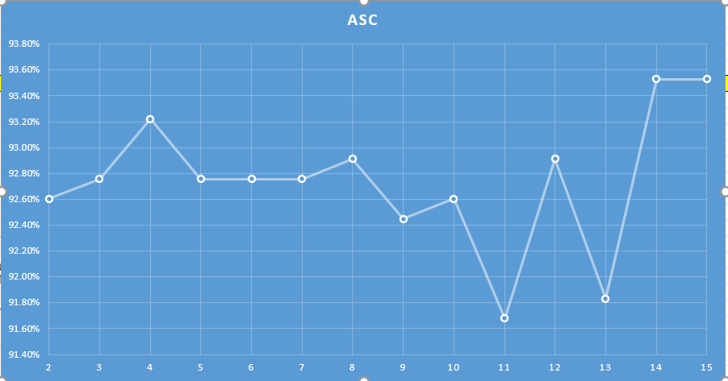
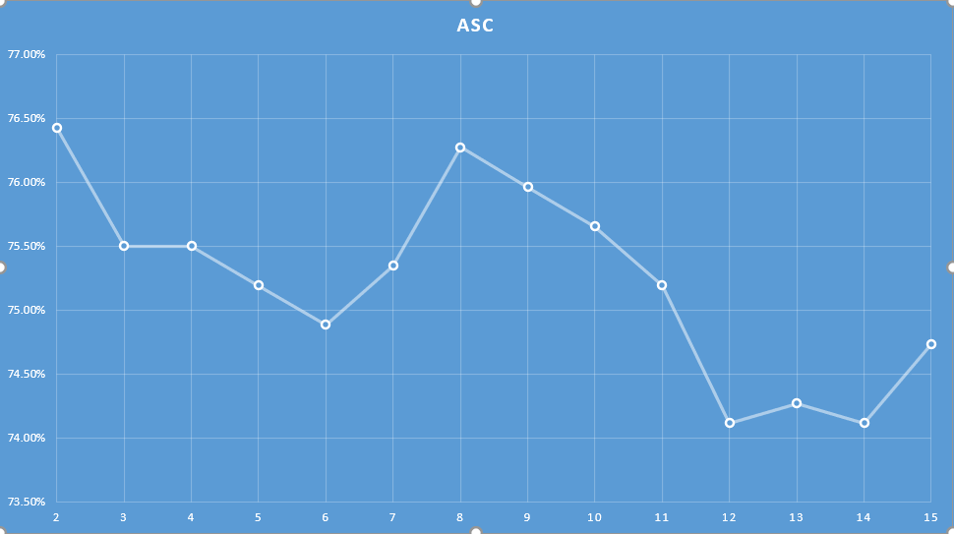
Analysis and Graphs
----- ----- -----
5 level Classify
Binary Classify
Attribute selected Classifier .

Slide 20
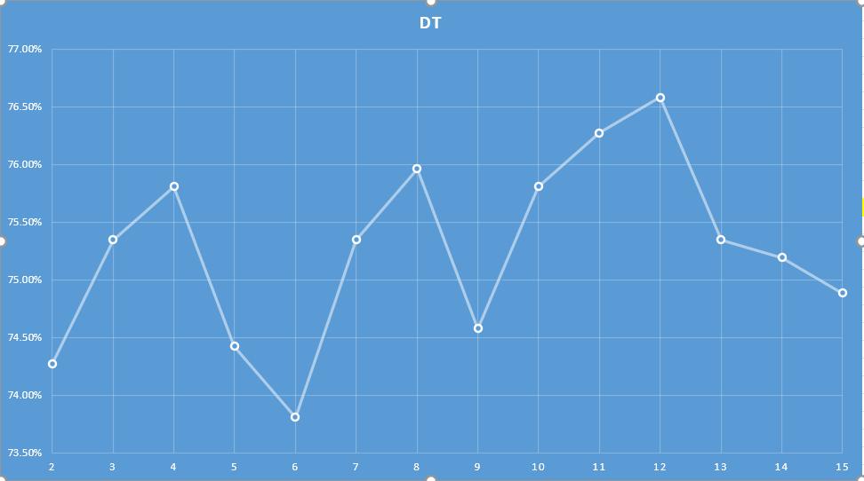
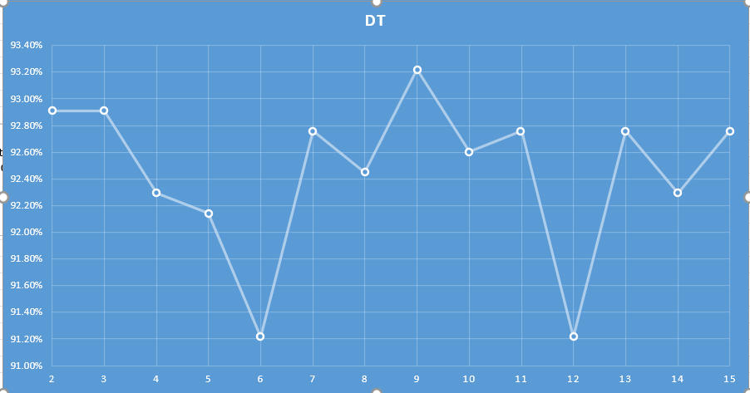
Analysis and Graphs
----- ----- -----
5 level Classify
Binary Classify
Decision Table (DT)

Slide 21
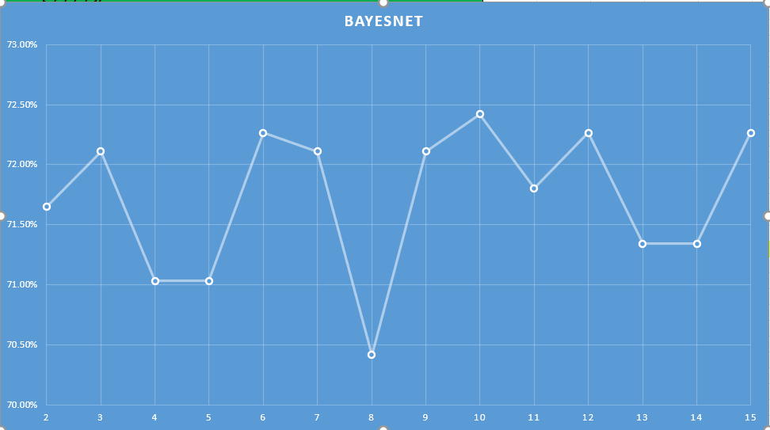
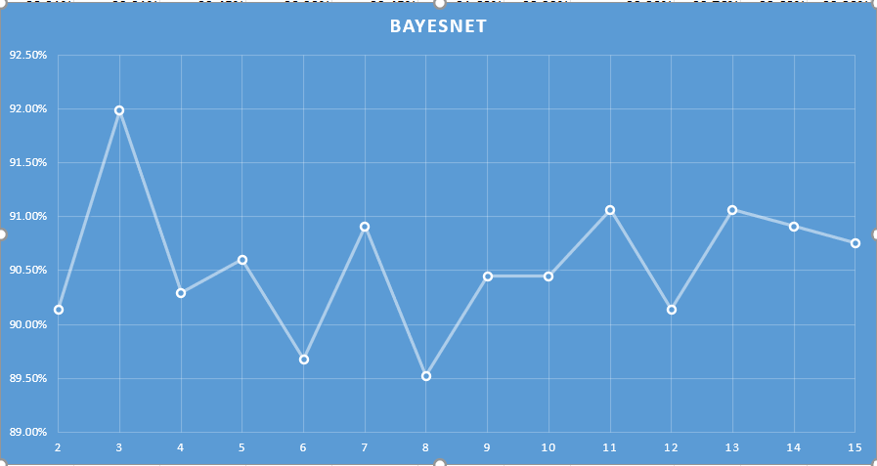
Analysis and Graphs
----- ----- -----
5 level Classify
Binary Classify
Bayesnet

Slide 22
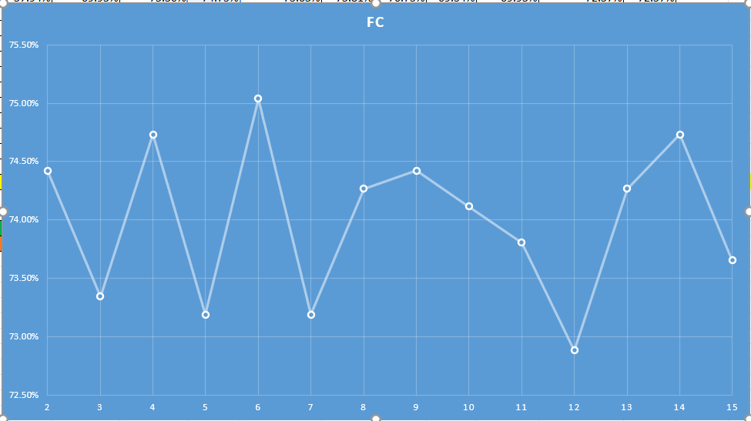
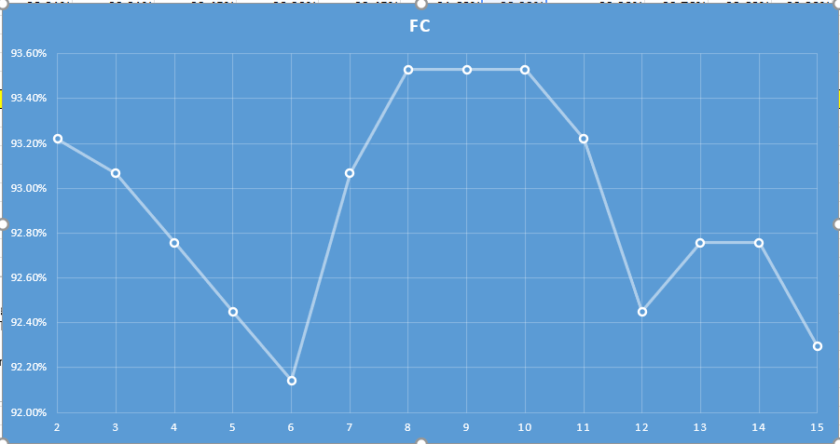
Analysis and Graphs
----- ----- -----
5 level Classify
Binary Classify
Filtered Classifier (FC)

Slide 23
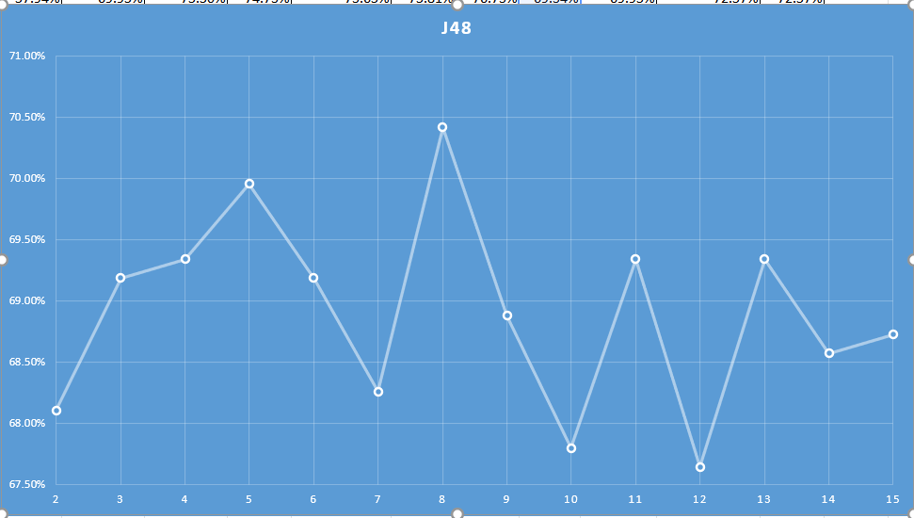
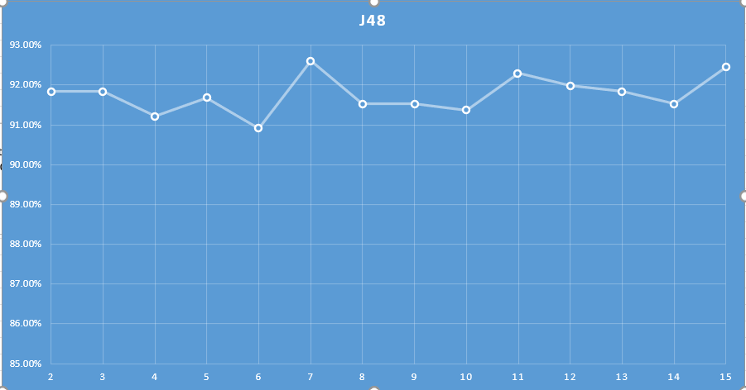
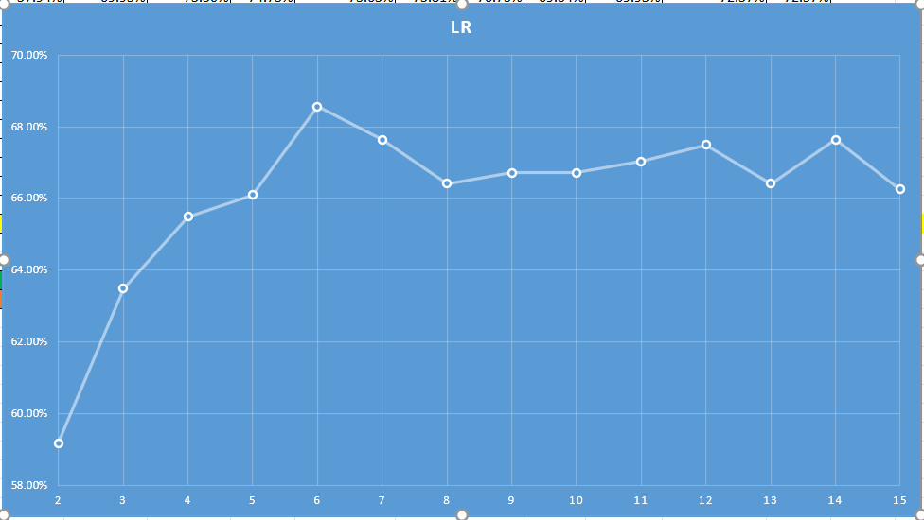
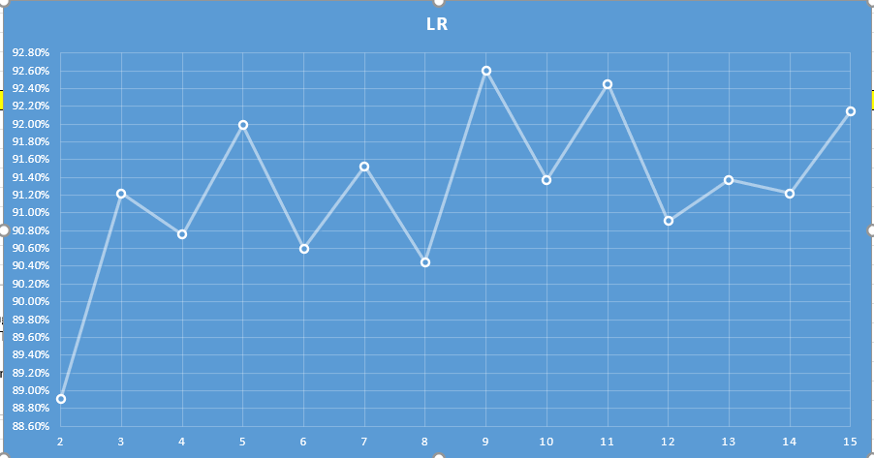
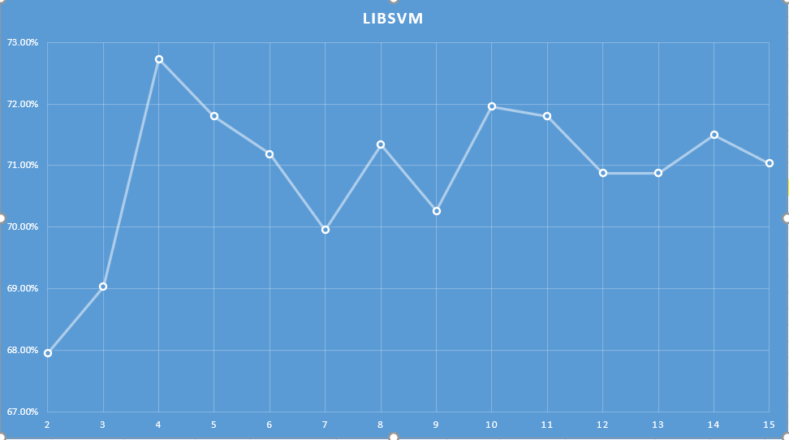
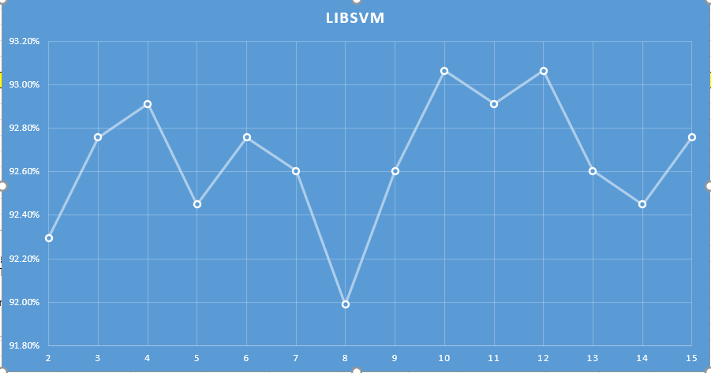
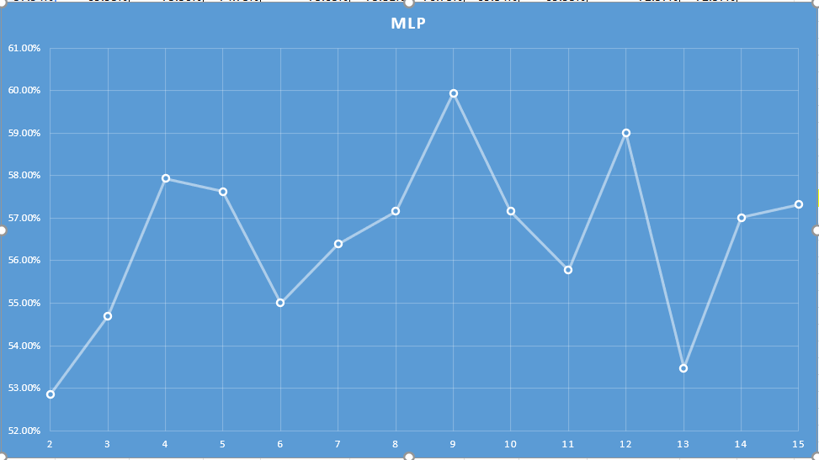
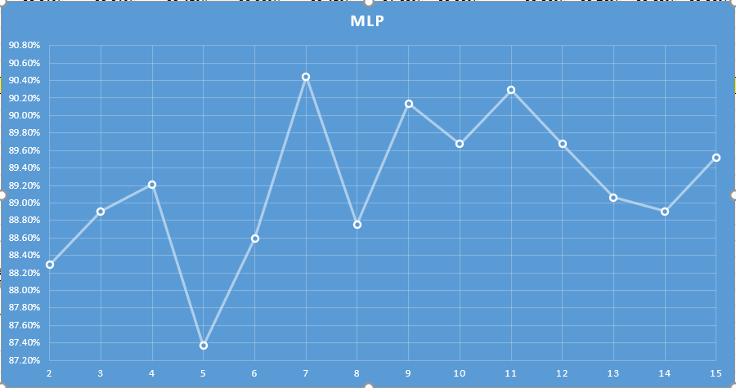
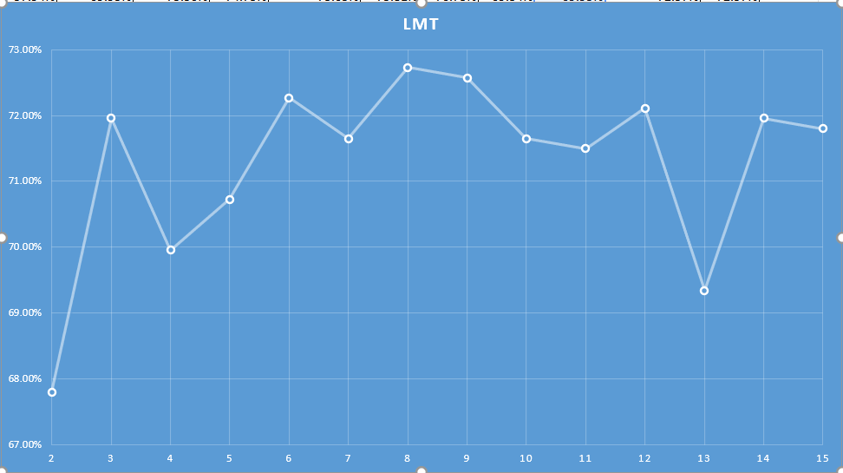
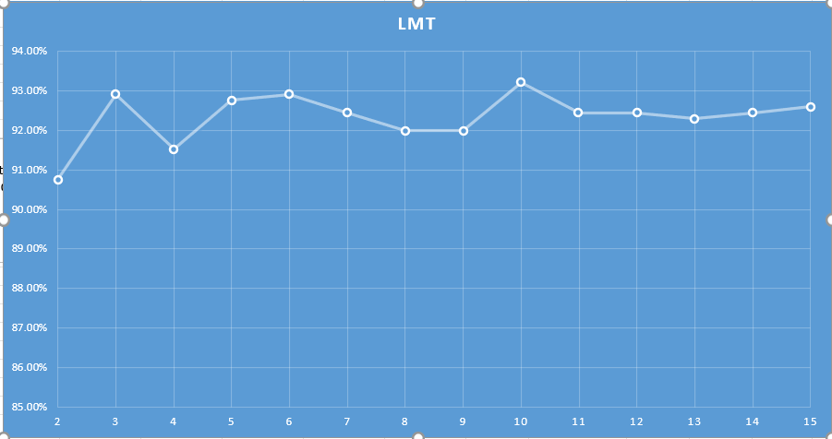
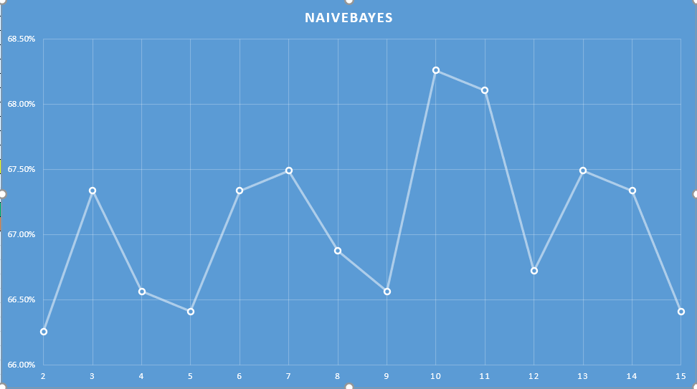
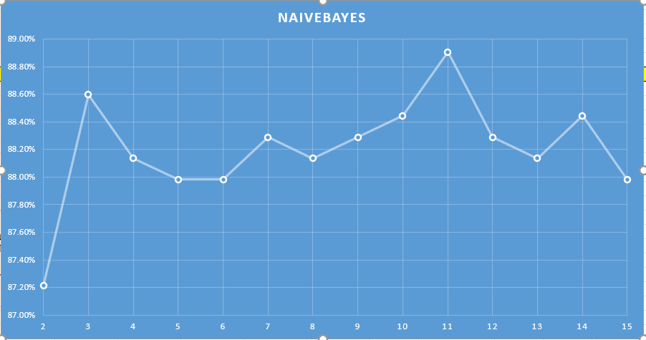
Analysis and Graphs
----- ----- -----
5 level Classify
Binary Classify
5 level Classify
Binary Classify
j48
LR
LibSVM
MLP
LMT
Naivbayes

Slide 24
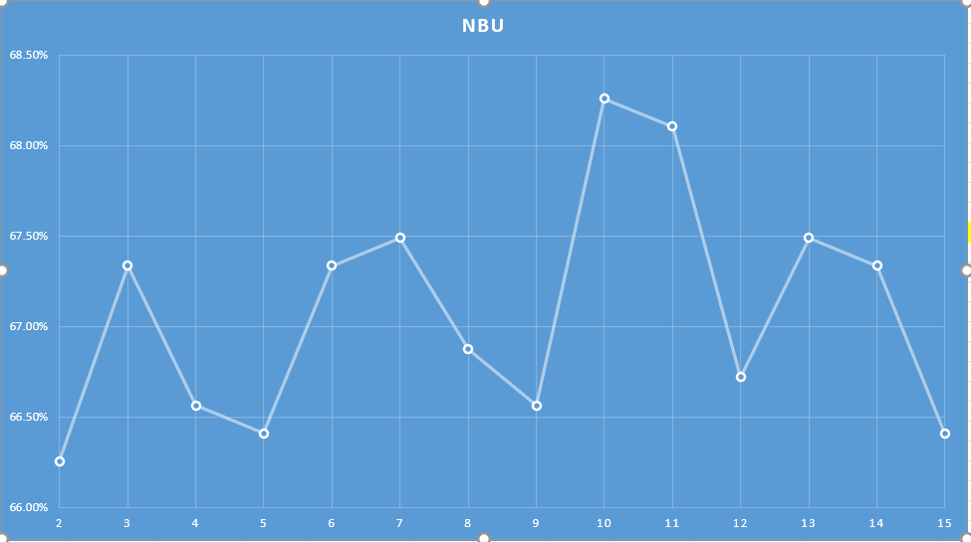
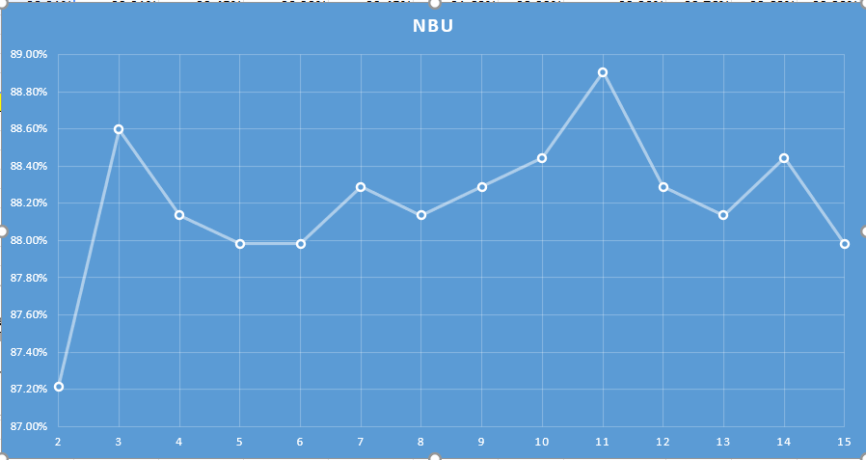
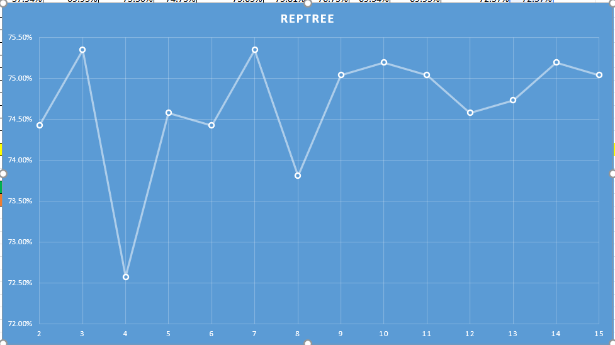
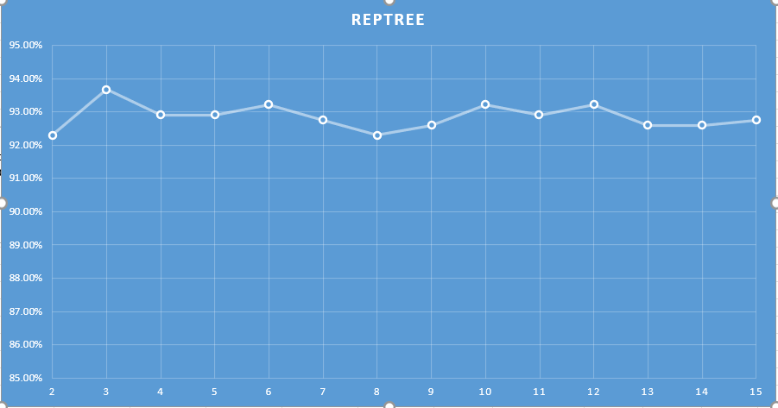
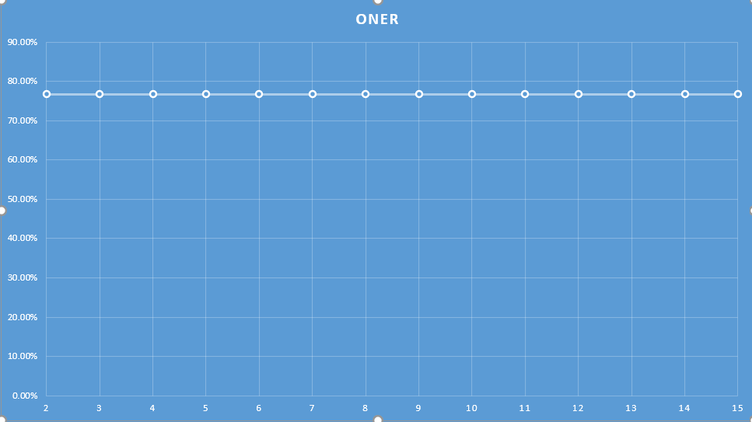
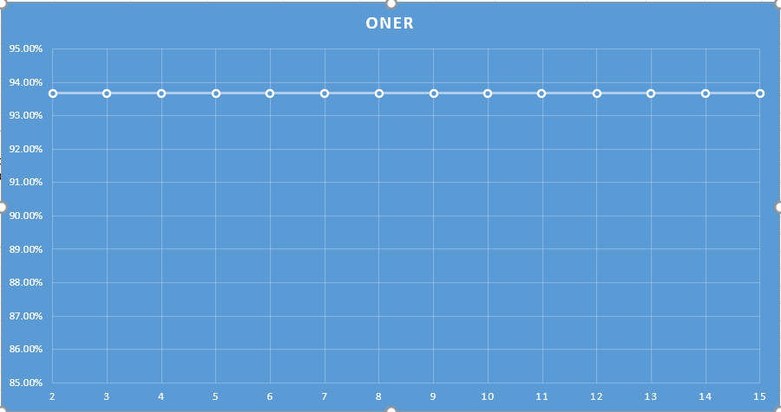
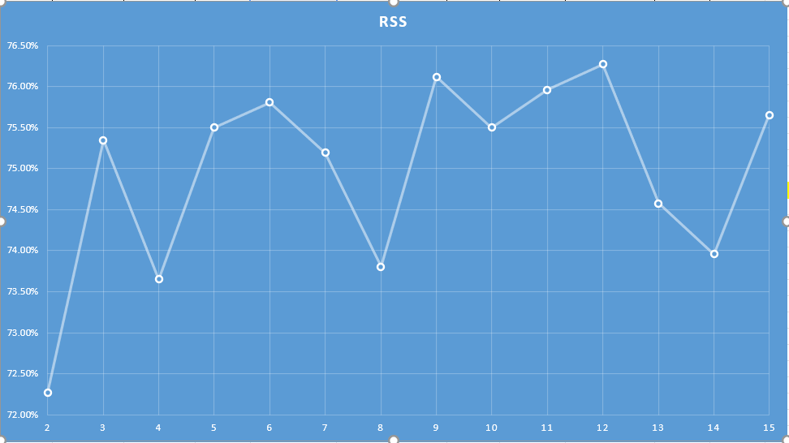
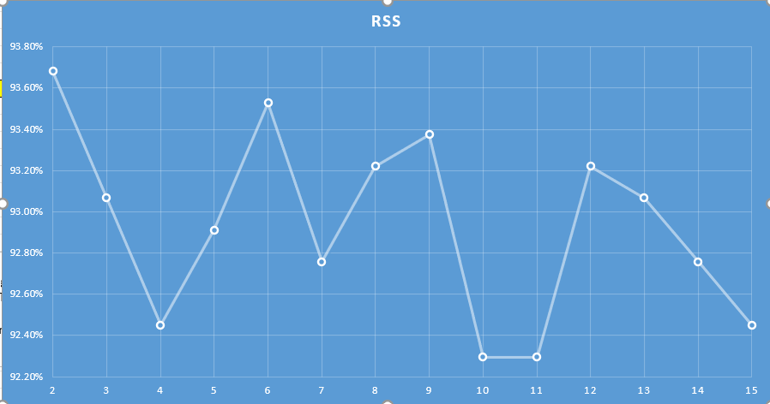
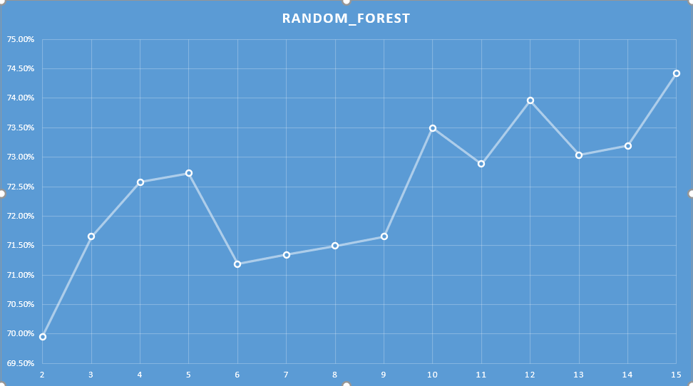
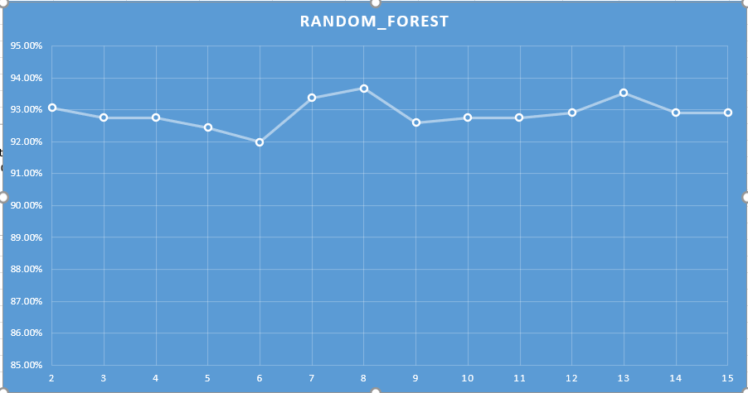
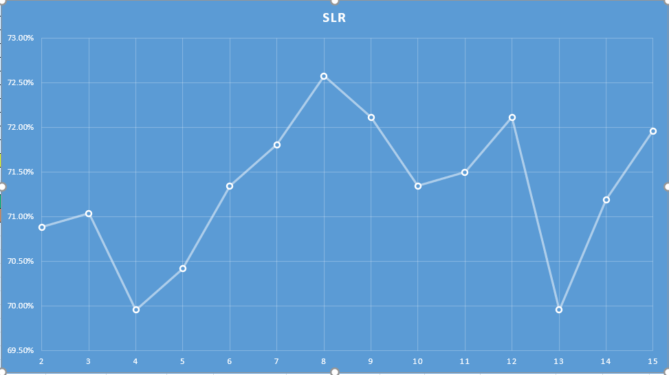
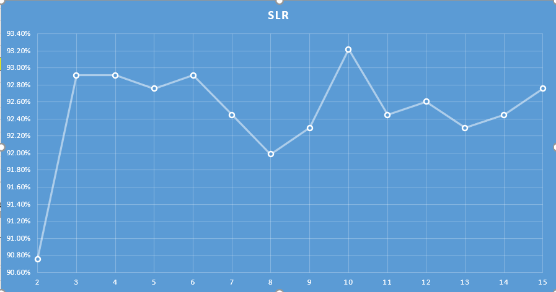
Analysis and Graphs
----- ----- -----
5 level Classify
Binary Classify
5 level Classify
Binary Classify
NBU
Rep tree
OneR
RSS
Random
forest
SLR

Slide 25
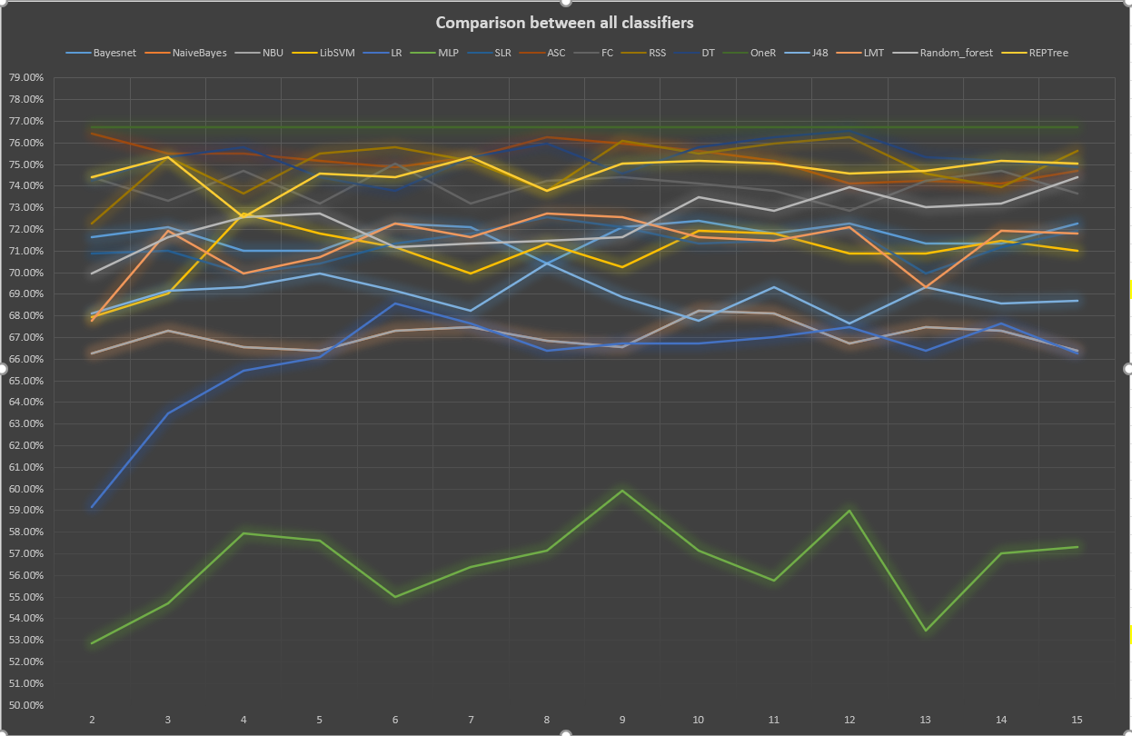
Analysis and Graphs
----- ----- -----
5 Lvl

Slide 26
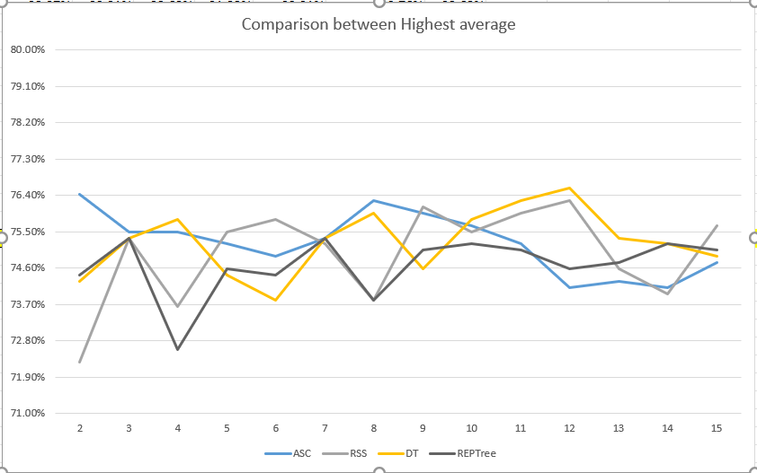
Analysis and Graphs
----- ----- -----
AVG:
Decision Table: 75.26%
Attribute Selected Classifier: 75.23%
5 Lvl

Slide 27
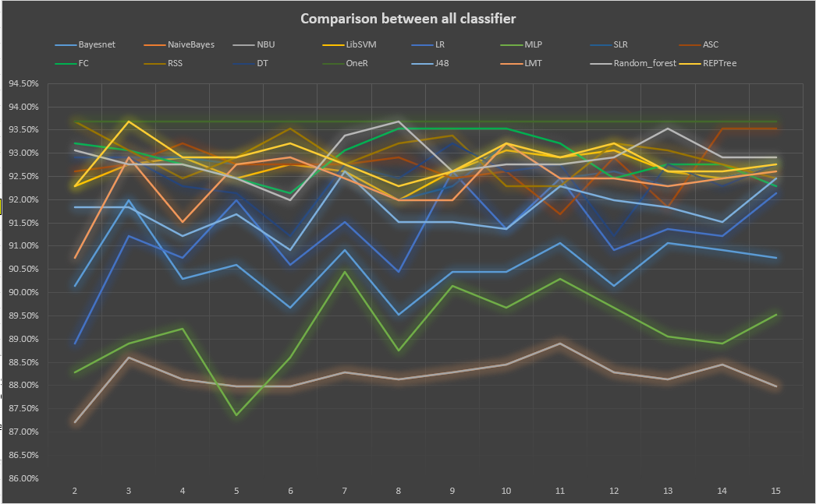
Analysis and Graphs
----- ----- -----
Bin

Slide 28
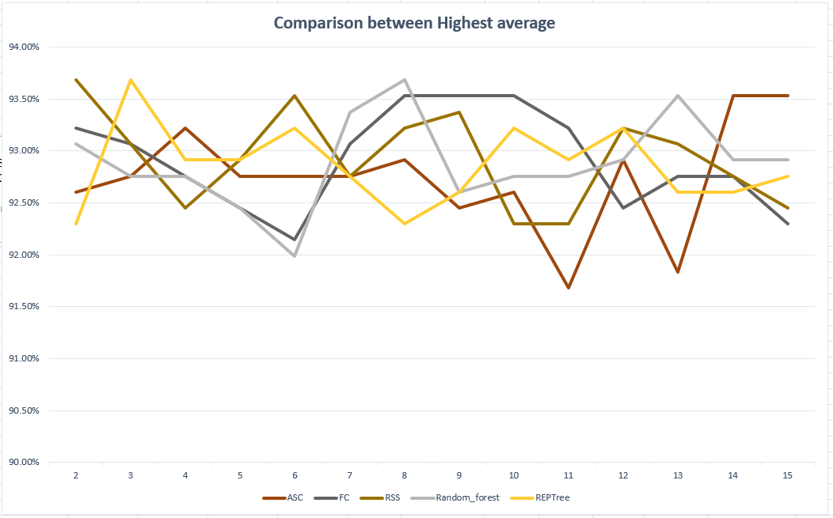
Analysis and Graphs
----- ----- -----
AVG:
Random Sub Space: 92.93%
Bin

Slide 29
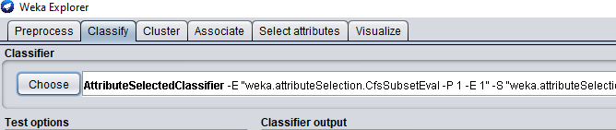
Classifier Selection
----- ----- -----
DT
74.27%
75.35%
75.81%
74.42%
73.81%
75.35%
75.96%
74.58%
75.81%
76.27%
76.58%
75.35%
75.19%
74.88%
75.26
ASC
76.43%
75.50%
75.50%
75.19%
74.88%
75.35%
76.27%
75.96%
75.65%
75.19%
74.11%
74.27%
74.11%
74.73%
75.23

Slide 30
Classifier Selection
----- ----- -----
DT
74.27%
75.35%
75.81%
74.42%
73.81%
75.35%
75.96%
74.58%
75.81%
76.27%
76.58%
75.35%
75.19%
74.88%
75.26
ASC
76.43%
75.50%
75.50%
75.19%
74.88%
75.35%
76.27%
75.96%
75.65%
75.19%
74.11%
74.27%
74.11%
74.73%
75.23

Slide 31
Extracting Model
----- ----- -----

Slide 32
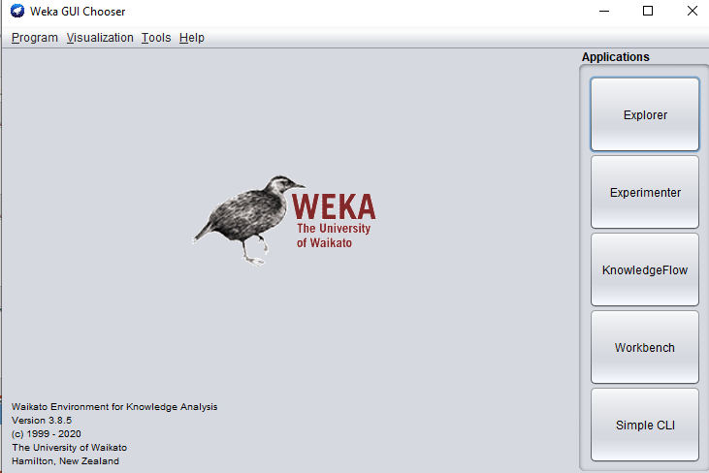
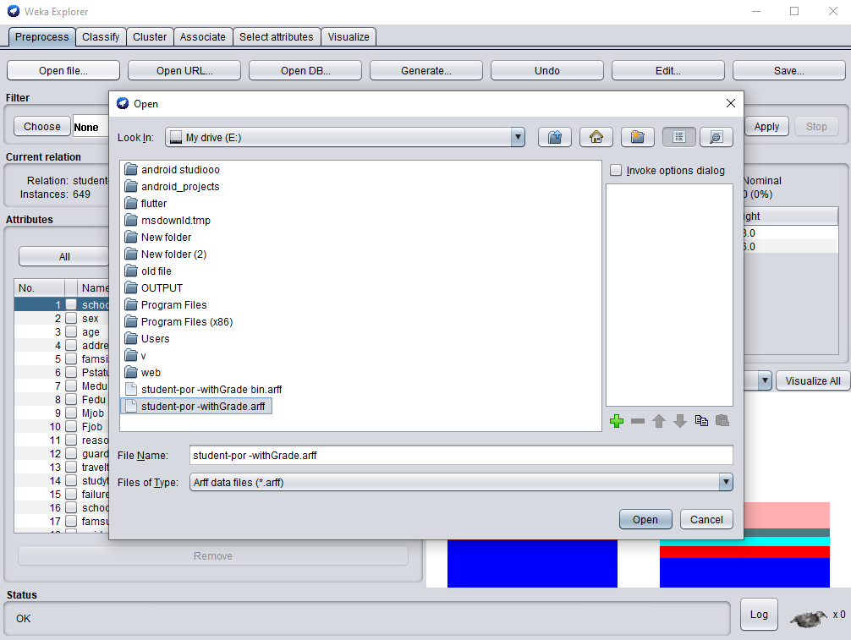
Extracting Model
----- ----- -----

Slide 33
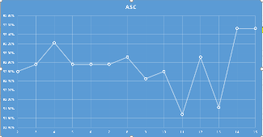
Extracting Model
----- ----- -----

Slide 34
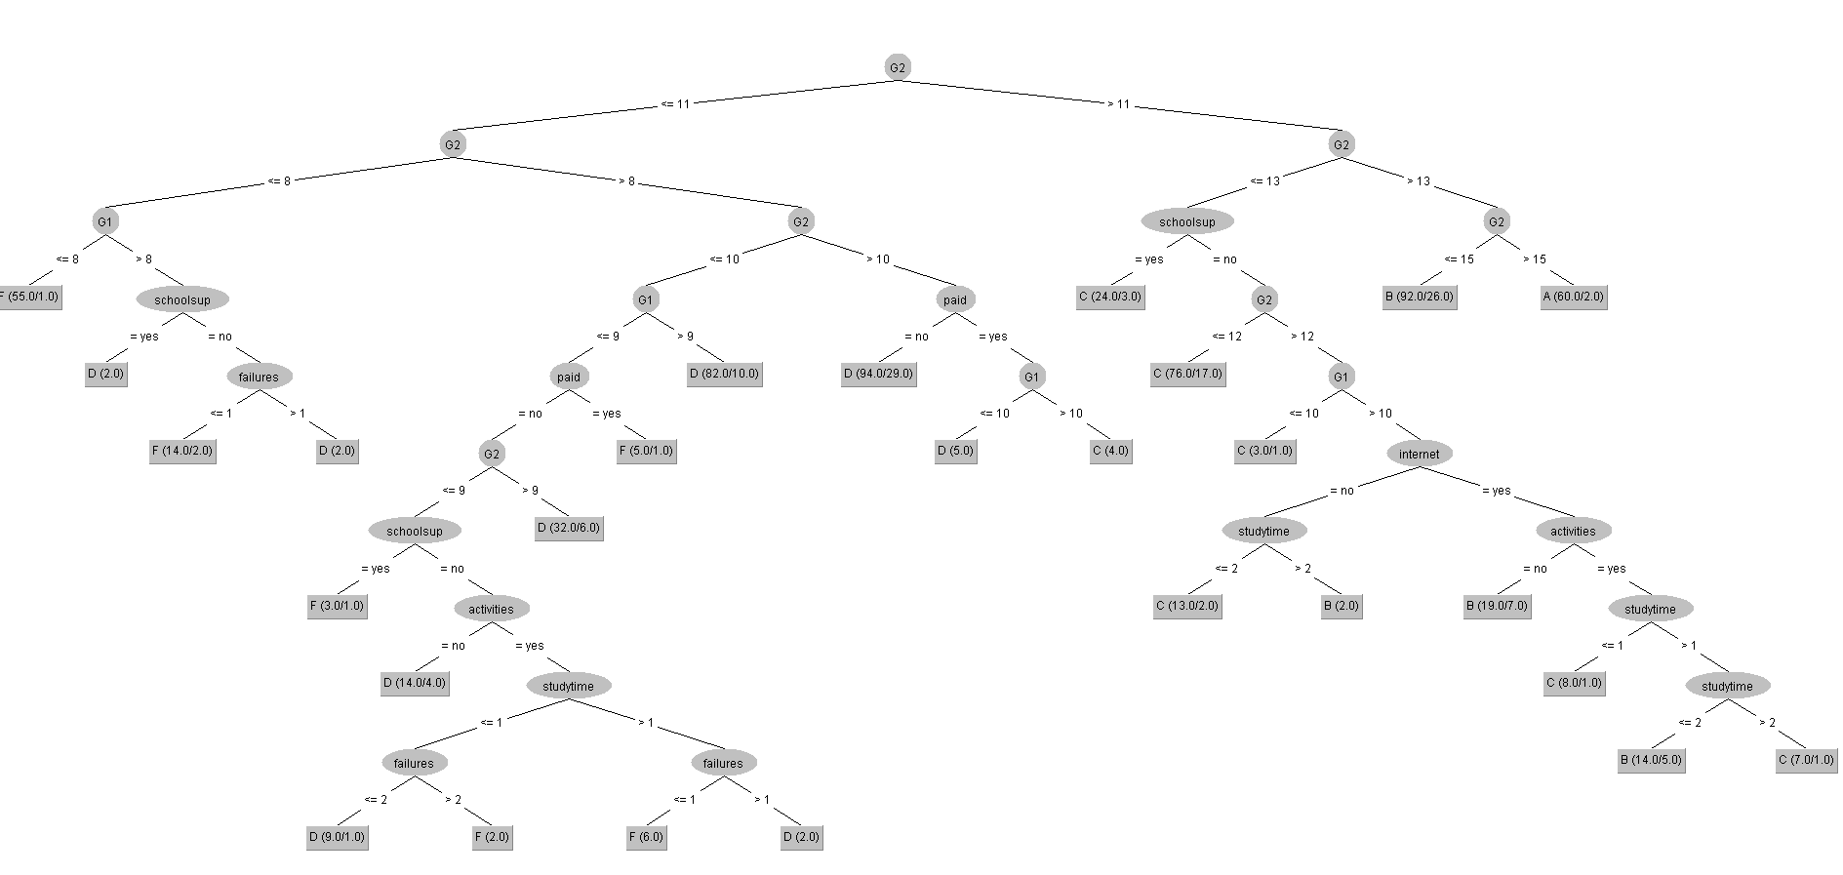
Extracting Model
----- ----- -----
Tree view

Slide 35
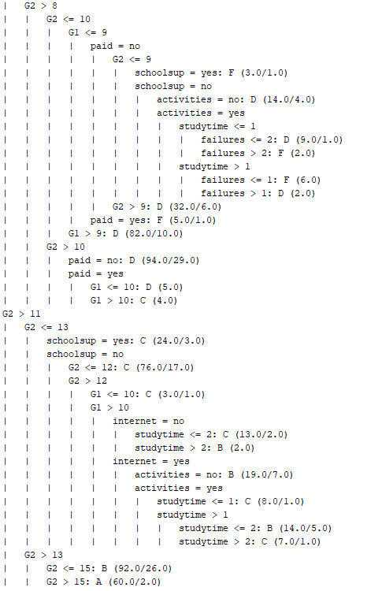
Extracting Model
----- ----- -----
Tree view
Classifier Model

Slide 36
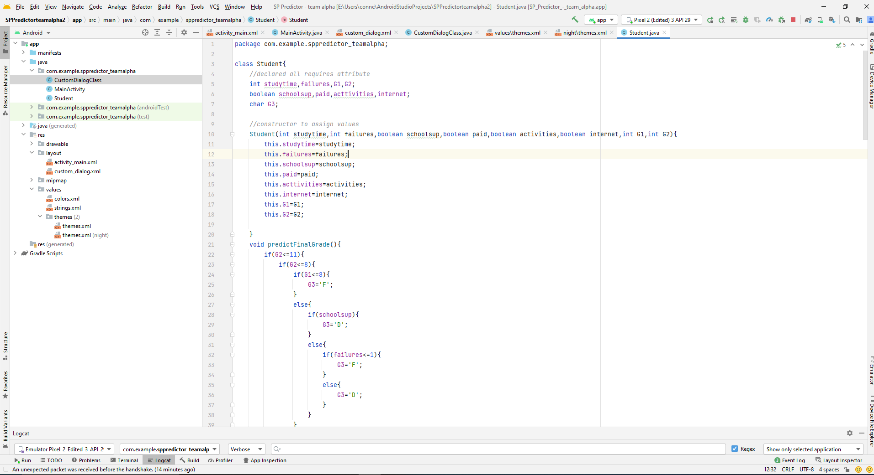
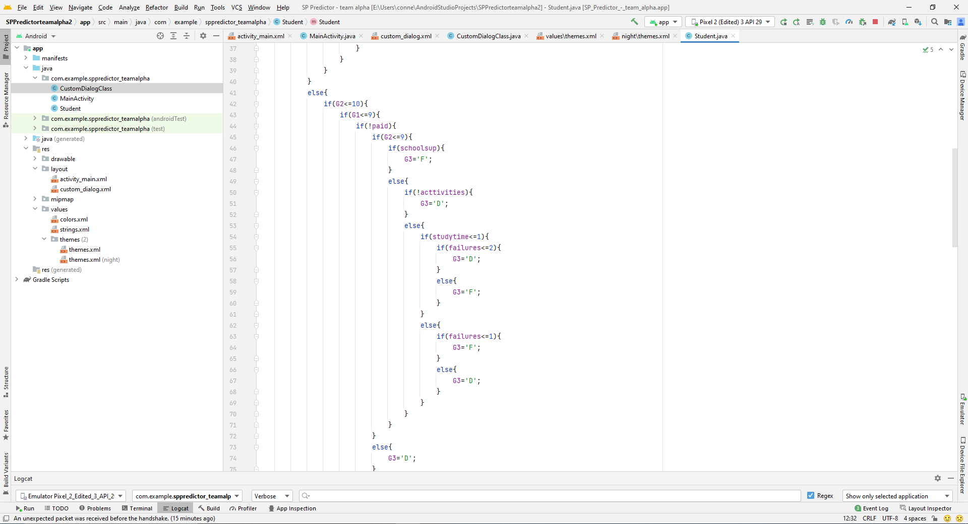
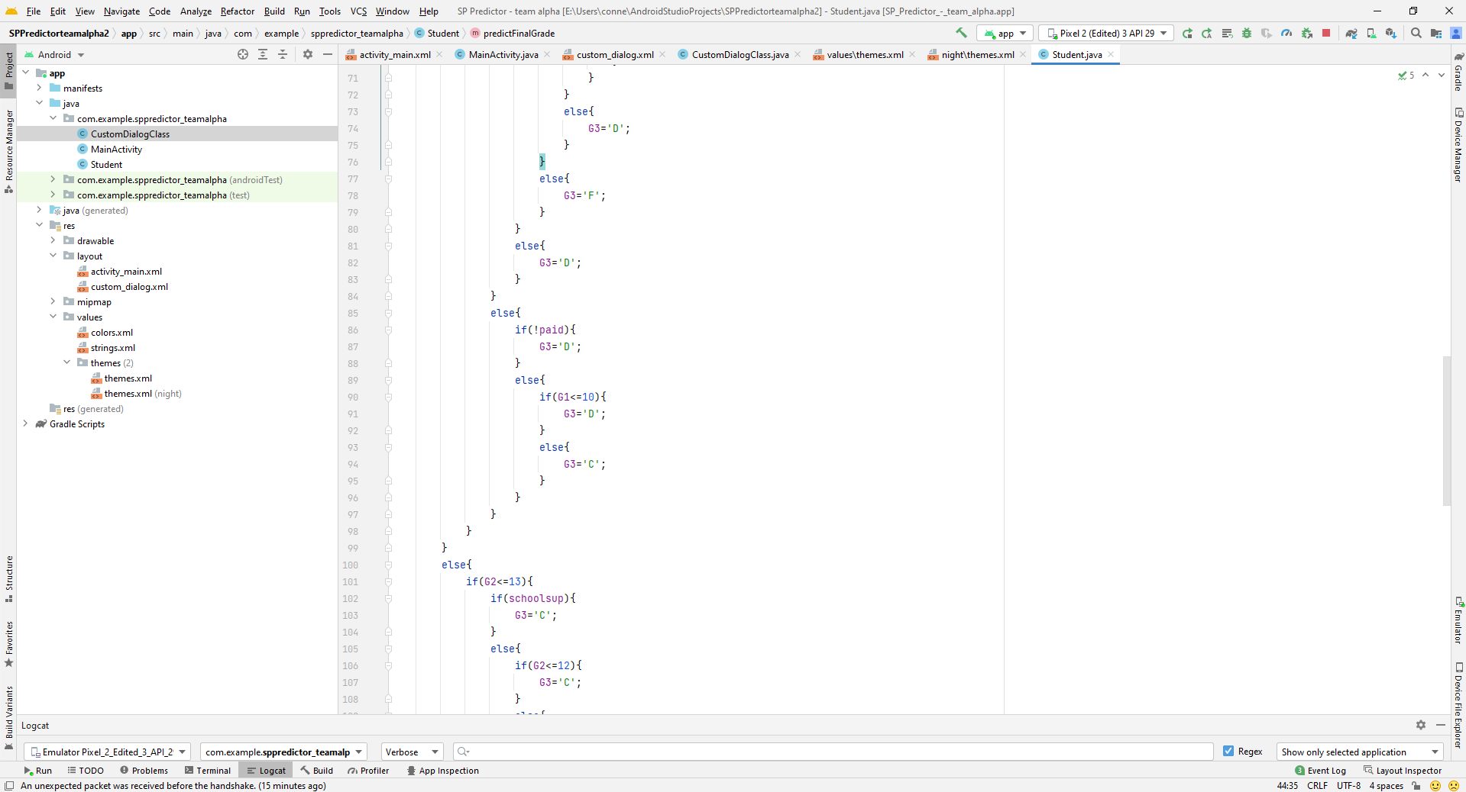
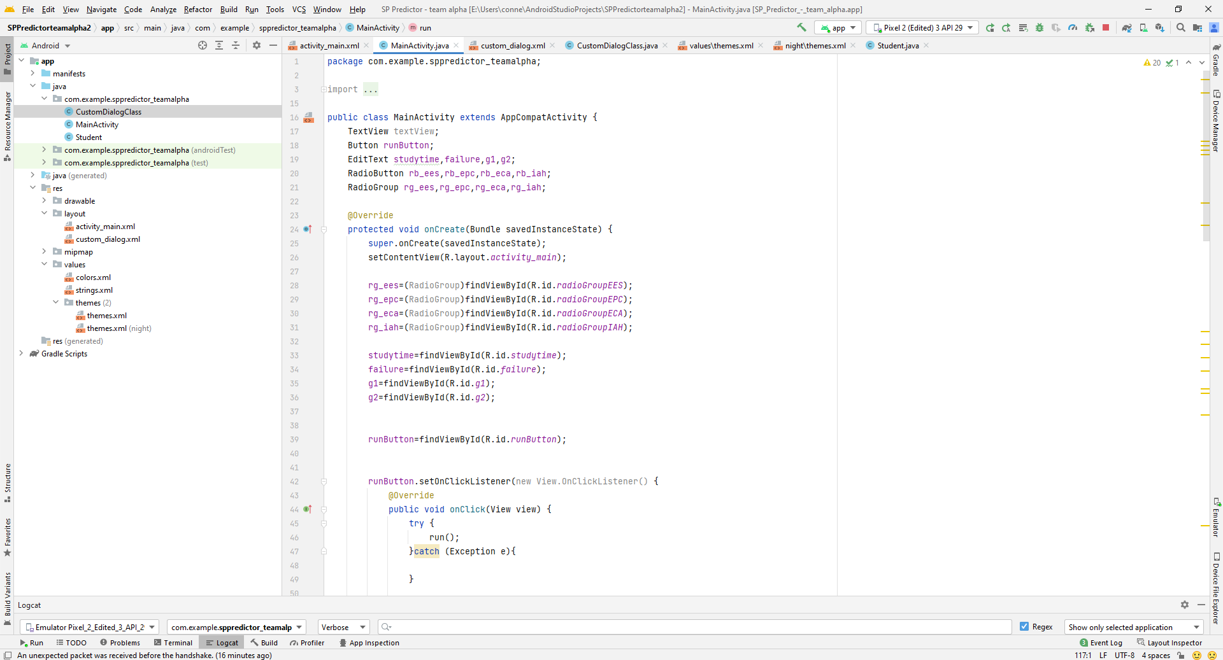
Implementing Model
----- ----- -----

Slide 37
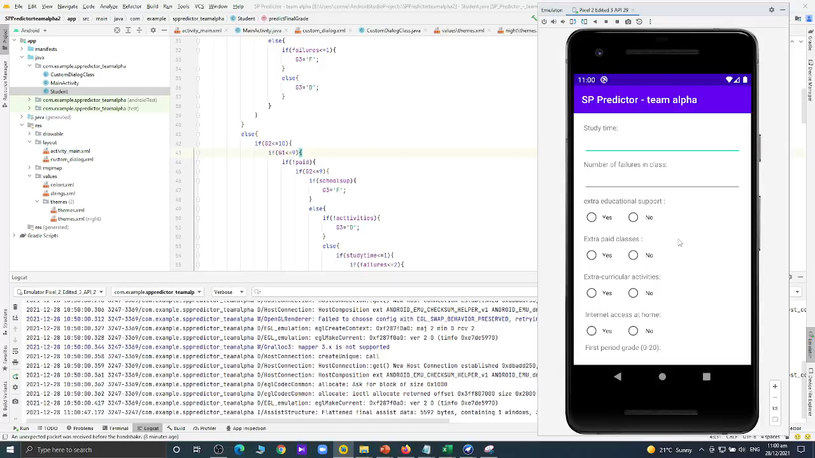
Android Application
----- ----- -----

Slide 38
Conclusions
----- ----- -----
Classifying students based on performance is very important. Data-driven decision making is an essential component of a multi-tiered support system.
Dataset Information
Attributes Information
Grading System preprocess
Analysis and Graph
Classifier selection
Building model
Android Application

Slide 39
References
----- ----- -----
#ref 1 : P. Cortez and A. Silva. Using Data Mining to Predict Secondary School Student Performance. In A. Brito and J. Teixeira Eds., Proceedings of 5th FUture BUsiness TEChnology Conference (FUBUTEC 2008) pp. 5-12, Porto, Portugal, April, 2008, EUROSIS, ISBN 978-9077381-39-7.
#ref 2 datasets https://www.kaggle.com/larsen0966/student-performance-data-set
#Other study materials
#lab manuals

Slide 40
Any Questions?

